Slide 1
PROJECT TITLE: Conversational Image Recognition Chatbot
CSE7101- Capstone Project
Review-4
Batch Number: ISE_15
Under the Supervision of,
Mr. Jai Kumar B
Assistant Professor
School of Computer Science and Engineering
Presidency University
Roll Number | Student Name
20221ISE0046 | K KEERTHI
20221ISE0085 | ADITI N
20221ISE0055 | RAVI RAJ P MATH
Name of the Program: Information Science and Engineering
Name of the HoD: Dr. Zafar Ali Khan N
Name of the Program Project Coordinator: Ms. Suma N G
Name of the School Project Coordinators: Dr. Sampath A K , Dr. Geetha A

Slide 2
Problem Statement Number:
Organization: Bharat Electronics Limited (BEL)
Category (Hardware / Software / Both): Software
Problem Description: Ever since the advent of AI and computer vision, modeling conversations has remained a challenge—especially when combining natural language processing (NLP) and image recognition. While popular chatbots like Apple’s Siri, Google Assistant, and Microsoft’s Cortana excel at language-based interactions, they lack advanced visual understanding. This project focuses on developing a deep learning–based conversational chatbot capable of recognizing objects in images uploaded by users and engaging in relevant, context-aware dialogue about them. The chatbot will not only detect objects but also answer questions regarding the image with grammatically correct and lexically precise responses, enhancing user experience in areas such as automation, accessibility, and interactive learning.

Slide 3
Problem Statement & Objective
Problem Statement: Existing chatbots process only text or speech and cannot interpret visual information. This limits their ability to handle real-world, image-based queries.
Objective: To design and implement a multimodal AI chatbot that detects objects, generates image captions, and provides conversational responses using YOLOv8, BLIP-2, and LLaMA-3.

Slide 4
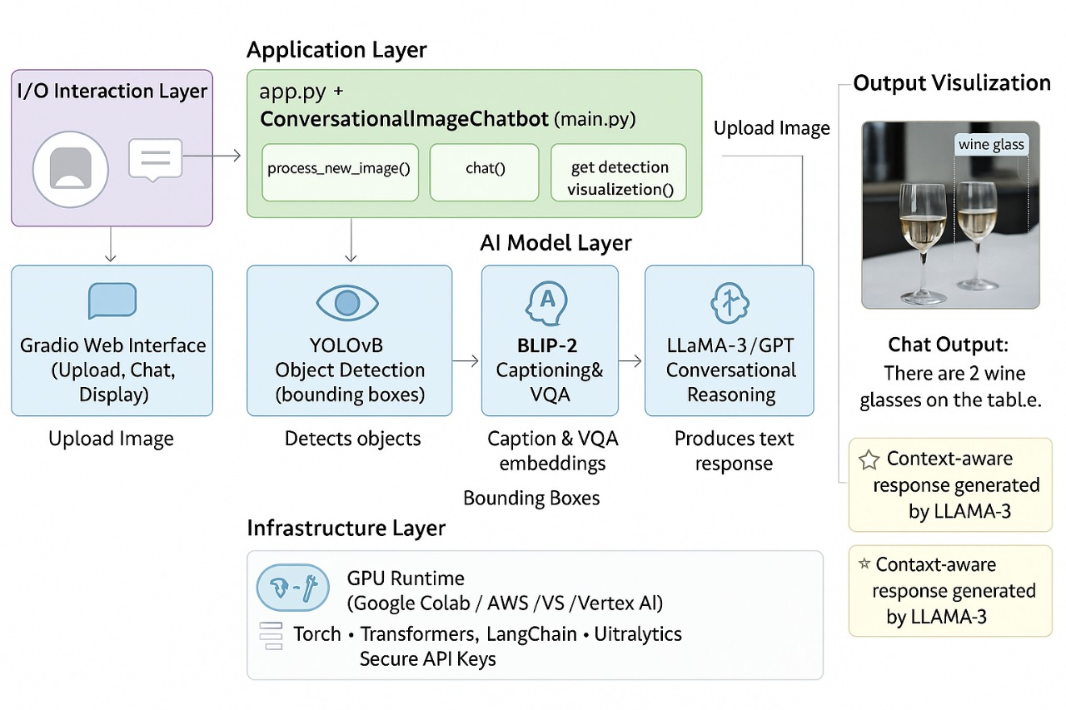
System Architecture
Architecture Description:
YOLOv8: Detects and labels objects in the uploaded image using bounding boxes.
BLIP-2: Generates image captions and answers visual questions for deeper understanding.
LLaMA-3: Provides context-aware conversational responses based on image insights.
Gradio: Enables users to upload images, ask questions, and view results interactively.
Output: Produces annotated images and natural text responses for multimodal interaction.

Slide 5
Implementation Progress (80% Completed)
Module | Status | Remarks
YOLOv8 | Completed | Object detection working with high accuracy
BLIP-2 | Completed | Image captioning and VQA integrated
LLaMA-3 (Groq API) | Completed | Conversational reasoning with memory
Gradio Interface | Completed | User interaction & visualization ready
Optimization | Ongoing | Minor tuning for faster responses

Slide 6
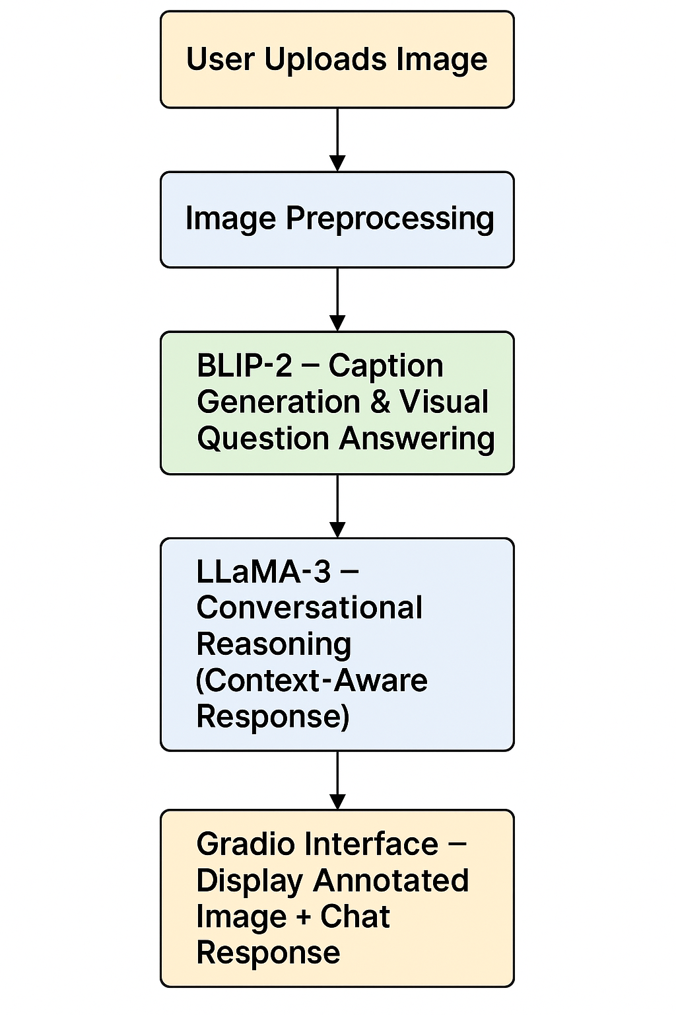
System Workflow
1. Upload image via Gradio: User uploads an image or asks a visual query through the Gradio interface. 2. YOLOv8: Detects and labels multiple objects in the image using bounding boxes. 3. BLIP-2: Generates image captions and answers user-specific visual questions. 4. LLaMA-3: Produces natural, context-aware conversational responses based on image understanding. 5. Output: Annotated image and text-based chatbot response are displayed interactively via Gradio.

Slide 7
Challenges
Challenges Faced:
Managing GPU and API limitations during integration
Fine-tuning visual question answering
Maintaining multi-turn conversation consistency

Slide 8
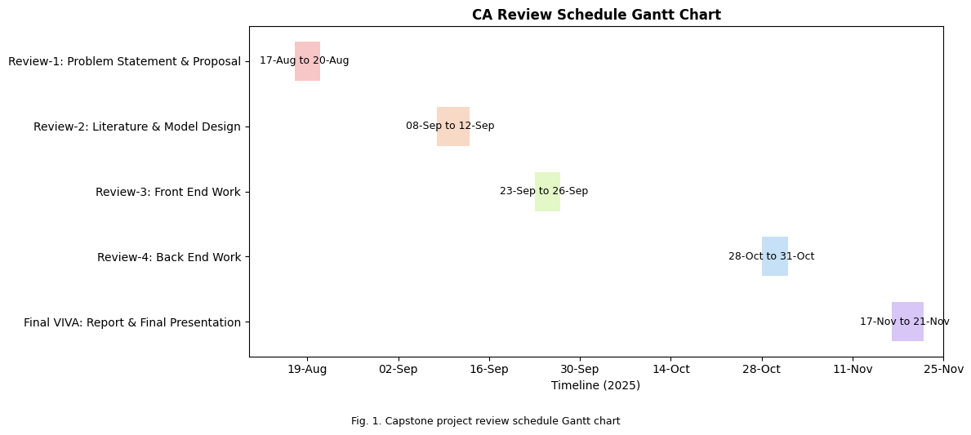
Timeline of the Project (Gantt Chart)

Slide 9
Github Link
The Github link provided should have public access permission.
Github Link
Conversational-Image-Recognition-Chatbot

Slide 10
References (IEEE Paper format)
[1]N. Arora, S. Talesara, S. Sharma, et al., "CONVERSATIONAL IMAGE RECOGNITION CHATBOT," Journal of Emerging Technologies and Innovative Research (JETIR), 2025.
[2]N R. Kolte, H. Wanwe, P. Sathawane, et al., "CONVERSATIONAL IMAGE RECOGNITION CHATBOT," International Research Journal of Modernization in Engineering Technology and Science (IRJMETS), 2024
[3]L. Kesa, S. Takur, K. Pasupuleti, et al., "Chatbot with Facemask Detection Technique," International Journal For Research in Applied Science and Engineering Technology (IJRASET), 2021.
[4]H. Li, Y. Lu, and H. Zhu, "Multi-Modal Sentiment Analysis Based on Image and Text Fusion Based on Cross-Attention Mechanism," Electronics, 2024.
[5]D. Prannav, A. Anwar, S. Sunayana, et al., "Image Caption Generation Using Deep Learning," Journal of Information Systems Engineering and Management, 2025.
[6]H. Chordia, R. Saxena, and G. Lavania, "Conversational Image Recognition Chatbot," Pratibodh - A Journal for Engineering, 2025.

Slide 11


